Slide 1
Determining a location to set up a medical laboratory using geolocation data and SVM models
Sergio Navarro

Slide 2
1.Introduction
Business problem:
Dynacare Medical Laboratories would like to expand in Calgary, but do not know where would be a suitable location to place a laboratory
Approach to the solution:
Analyze geolocation data with a machine learning model to suggest potential locations to set up a laboratory

Slide 3
2. Data – the data sets
Positive-only
Positive-unlabelled
To analyze
Neighborhoods where Dynacare has already set up laboratories
All the neighborhoods of cities with laboratories
All the neighborhoods of Calgary

Slide 4
2. Data – source of the data
Obtain postal codes of the neighborhoods of interest using wikipedia or Dynacare's website
Obtain latitudes and longitudes using latlong.net
Obtain venues of neighborhoods using Foursquare API

Slide 5
2. Data – examples with coordinates
Postal code | Neighborhood | Latitude | Longitude
G1C | example lab 1 | 46.881771 | -71.189369
G1E | example lab 2 | 46.860130 | -71.194054
G1M | example lab 3 | 46.817230 | -71.269836
G6W | example lab 4 | 46.757560 | -71.225570
H1K | example lab 5 | 45.608180 | -73.544520

Slide 6
2.Data - example with venues
Neighborhood name | Bakery | Bank | Bar | Breakfast Spot | Construction & Landscaping
Braeside, Cedarbrae, Woodbine | 0.000000 | 0.000000 | 0.000000 | 0.000000 | 0.5
Brentwood, Collingwood, Nose Hill | 0.000000 | 0.000000 | 0.000000 | 0.333333 | 0.000000
Bridgeland, Greenview, Zoo, YYC | 0.000000 | 0.000000 | 0.000000 | 0.000000 | 0.000000
City Centre, Calgary Tower | 0.022222 | 0.022222 | 0.066667 | 0.000000 | 0.000000

Slide 7
3.Methodology
Models:
For positive-only data: one-class suport vector machine
For positive-unlabelled data: Elkanoto support vector machine
Visualization:
Labeled map with follium

Slide 8
4. Results – model evaluation
Positive only
Positive-unlabelled
Test size | Jaccard score | F1 Score
0.05 | 0.400000 | 0.571429
0.10 | 0.400000 | 0.571429
0.15 | 0.533333 | 0.695652
0.20 | 0.578947 | 0.733333
0.25 | 0.541667 | 0.702703
0.30 | 0.517241 | 0.681818
0.35 | 0.558824 | 0.716981
0.40 | 0.552632 | 0.711864
0.45 | 0.465116 | 0.634921
0.50 | 0.520833 | 0.684932
Test size | Jaccard score | F1 Score
0.05 | 0.500000 | 0.666667
0.10 | 0.733333 | 0.846154
0.15 | 0.916667 | 0.956522
0.20 | 0.714286 | 0.833333
0.25 | 0.965517 | 0.982456
0.30 | 0.900000 | 0.947368
0.35 | 1.000000 | 1.000000
0.40 | 0.973684 | 0.986667
0.45 | 0.560976 | 0.718750
0.50 | 1.000000 | 1.000000

Slide 9
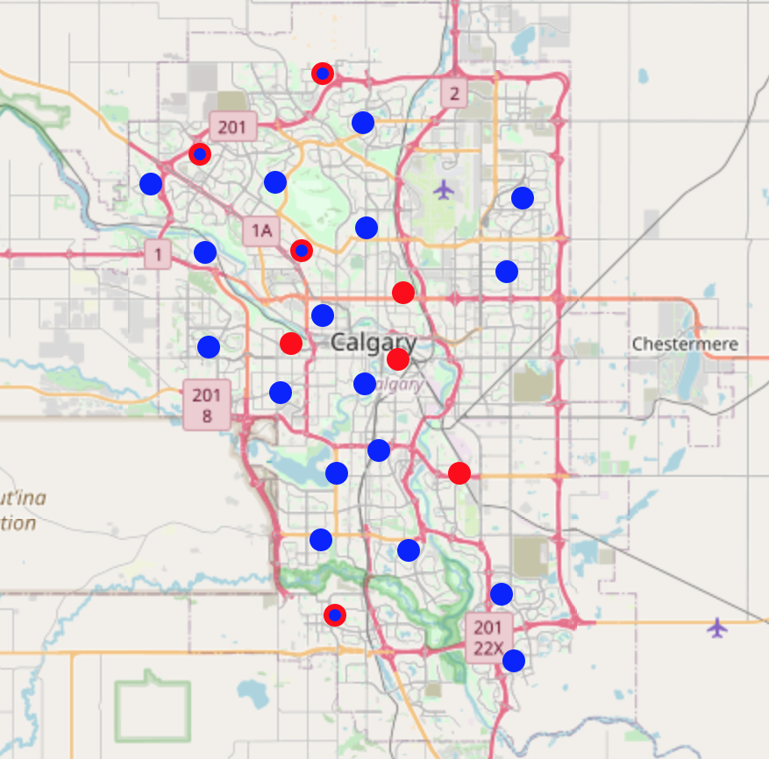
4. Results – suggested neighborhoods

Slide 10
5. Discussion
Models results
PU SVM was more numerous than positive-only
Most of the results were in the western side of the city
Both models suggest positions in the north and south of the city
Assumptions
Locations with labs represent positive locations
Locations without labs represent unlabelled locations
Limitations and recommendations
Try with other classification models
Other evaluation methods specific to PU learning

Slide 11
6. Consclusion
SVM can be used with geolocation data to suggest places to set up new businesses
PU learning is aplicable in many real-life situations

